Slide 1
Exercise
The B.Tech program of IITKgp Computer Science Department:
  comprises of many B.Tech batches.
Each B.Tech batch consists of many B.Tech students.
CSE Department has many listed courses.
  A course may be offered in different semesters
  A course is either listed as an elective course or a core course.
  Each B.Tech students need to credit between 30 to 32 course offerings.
  A student might repeat a course if he/she desires

Slide 2
Model Solution
BTech Program
*
1
BTech Batch
1
*
Student
*
Course List
*
30..32
credits
1
Course
Core
Elective
Course Credit

Slide 3
State Machine Diagrams

Slide 4
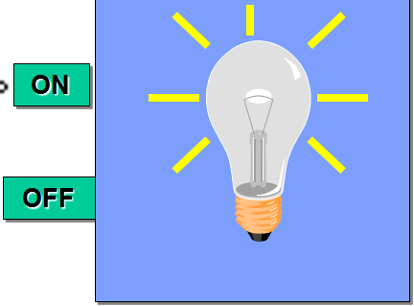
Stateless vs. Stateful Objects
State-independent (modeless):
  Type of objects that always respond the same way to an event.
State-dependent (modal):
  Type of objects that react differently to events depending on its state or mode.
  Use state machine diagrams for modeling objects with complex state-dependent behavior.
Lamp On
on
off
on
Lamp Off
off

Slide 5
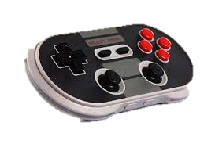
Stateful Classes
Give examples of some classes that have non-trivial state models:
  Lift controller: Up, down, standstill,…
  Game software controller: Novice, Moderate, Advanced…
  Gui: Active, Inactive, clicked once, …
  Robot controller: Obstacle, clear, difficult terrain…
Controller classes are an important class of statefull examples:
  A controller may change its mode depending on sensor inputs and user inputs.

Slide 6
Stateful Classes
In a client-server system:
  Servers are stateless, clients are stateful.
Common stateful objects:
  Controllers:
    A game controller may put the game in expert, novice or intermediate modes.
  Devices:
    A Modem object could be dialing, sending, receiving, etc.
  Mutators (objects that change state or role)
    A RentalVideo is rented, inStore, or overDue

Slide 7
Event-Based Programming
Traditional programs have single flow of control:
  Represented using flowchart or activity diagram
Event-driven systems :
  In contrast, depending on an event occurrence, corresponding handler is activated
  Programming these using traditional approach not suitable, and would at the least cause wasteful computations.
  Represented using state machines.

Slide 8
What Kind of Behavior?
In general, state machines are suitable:
  For describing event-driven, discrete behavior
  Inappropriate for modeling continuous behavior
threshold
  There is no support currently in UML for modeling continuous behavior
time

Slide 9
Why Create A State Model?
Tackle complexity
Document:
  For review, explaining to others, etc.
Generate code automatically
Generate test cases

Slide 10

Finite State Automaton
A machine whose output behavior is not only a direct consequence of the current input,
  But past history of its inputs
Characterized by an internal state which captures its past history.
ON
OFF

Slide 11
Basic State Machine Diagram
Graphical representation of automata behavior…
on
Lamp On
on
off
Lamp Off
off

Slide 12
Outputs and Actions
The automaton generates outputs.
  Alternate representations.
on
Lamp On
on
Lamp On
display(”on”)
off
on/display(”on”)
off
on
off
off
Lamp
Off
Lamp
Off
Mealy automaton
Moore automaton

Slide 13
Event-Driven Behavior
Event types:
  Object interactions:
    synchronous object operation invocation (call event)
    asynchronous signal reception (signal event)
  Occurrence of time instants (time event)
    interval expiry
    calendar/clock time
  Change in value of some entity (change event)
Event Instance = an instance of an event (type)
  occurs at a particular time instant and has no duration

Slide 14
Event Examples
Signal event
collision
Move
Stop
state
transition
state
startAutopilot(normal)
Manual
Automatic
Change event
Call event
when(11:49pm)
Time event
Idle
Active
after (2 seconds)

Slide 15
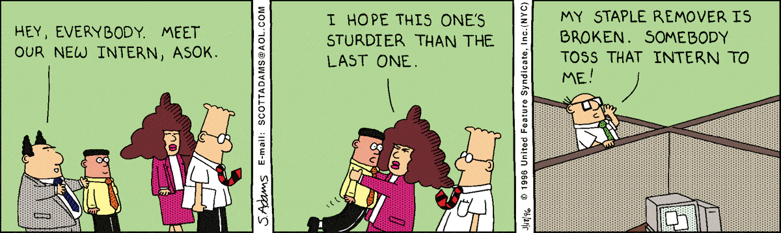

Slide 16
Exercise 0: Draw State Machine Diagram of a Keyboard?
Press any key: lower case ASCII code is sent to computer…
Once press the caps lock key: upper case ASCII code will be sent on a key press…
Any key/
send-lower-
Case-code
Default
Caps Lock
CapsLocked
Caps Unlock
AnyKey/
Send-upper-
Case-code

Slide 17
Exercise 1: State Machine Diagram of a Library Book
A library book to start with, is present in a shelf…
When borrowed out, it is not on shelf…
Returned, on shelf…
initial state
On shelf
state
discarded
Returned
Borrowed
transition
On loan
final state

Slide 18
Exercise 2: Construct State Model
A car is in idle mode when ignition is off:
  Changes to initial mode when ignition is keyed ON.
The car accelerates when the acceleration pedal is pressed.
While accelerating, the car goes into a cruise mode, as soon as cruise switch is set to ON.
Cruise mode is turned off either when brake is applied or the cruise switch is turned off
  Cruise mode can be resumed by setting cruise switch to ON.
  When ignition is turned off the car goes to idle mode.
Cruise Controller

Slide 19
Cruise Controller
Idle
Initial
Ignition On
Idle
Acccel Pedal Pressed
Ignition Off
Accelerating
Cruising off
Break Pressed
Cruise Switch OFF
Cruise
Switch ON
Cruise
Switch ON
Cruising

Slide 20
Exercise 3
Model a keyboard using UML state machine diagram:
  Transmits key code on each key stroke.
  Breaks down after entering 100,000 key strokes.

Slide 21
Solution
/n=0
Default
[n=100,000]
KeyStroke
keyStroke/
n++, transmit code
Broken

Slide 22
Exercise 4: Draw State Machine: GUI Accepts only Balanced Parentheses
(
Balanced
Not
Balanced
start
end
)
*
*
Inputs are any characters
No nesting of parentheses
No “output” other than any state change

Slide 23
Example 5: Draw State Machine: GUI Accepts only upto 3 Nested parentheses
end
(
(
(
OK
Wait 1
Wait 2
Wait 3
start
)
)
)
*
*
*
*
)
(
Error
How can we extend this machine to handle arbitrarily deep nesting of parentheses?
*

Slide 24
How to Model Nested parentheses?
(/count++
(/count=1
OK
Wait
start
end
)[count==1] /count=0
)[count>1]/ count--
A state machine, but not just a state machine --- an EFSM

Slide 25
Extended State Machines
Addition of variables (“extended”)
Lamp On
ctr : Integer
off
on/ctr = ctr + 1
Lamp Off

